Slide 1
Data Science Project
Reese Bottorff

Slide 2
Introduction
Used car dataset from Kaggle
Linear regression to find the price of the used car
In this presentation I will be discussing:
Background
Data processing
EDA
Splitting data
Training and test
Predictions

Slide 3
Background
Using this data, I will create a predictive model to accurately estimate the selling proce of a used car based on its features
Features/Columns include
Model = name of the car models
Year = the year the car was manufactured
Price = the price of the car
Transmission = the type of transmission
Mileage = the number of miles the car has been driven
FuelType = type of fuel the car uses
Tax = the amount of tax that is due on the car
Mpg = the miles per gallon that the car gets
EngineSize = the size of the car’s engine
Make = the manufacturer of the car

Slide 4
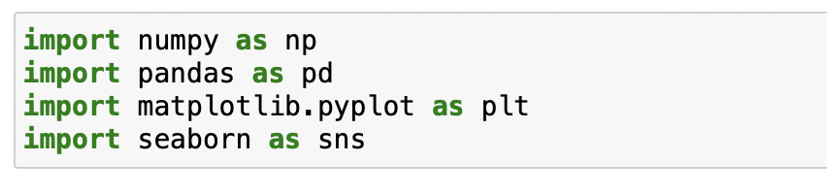
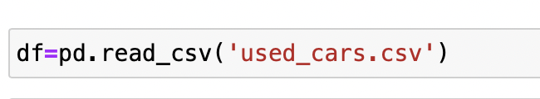
Data Processing
The first step to my model was to Import packages that allow me to complete the linear regression
Use pandas to import the dataset

Slide 5
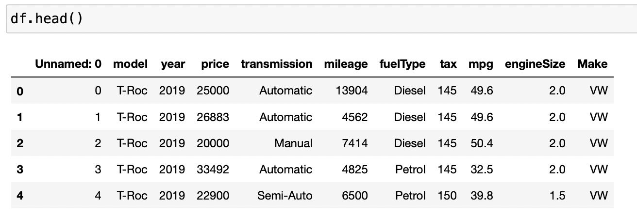
Data Processing
This is what the dataset looks like before changing anything

Slide 6
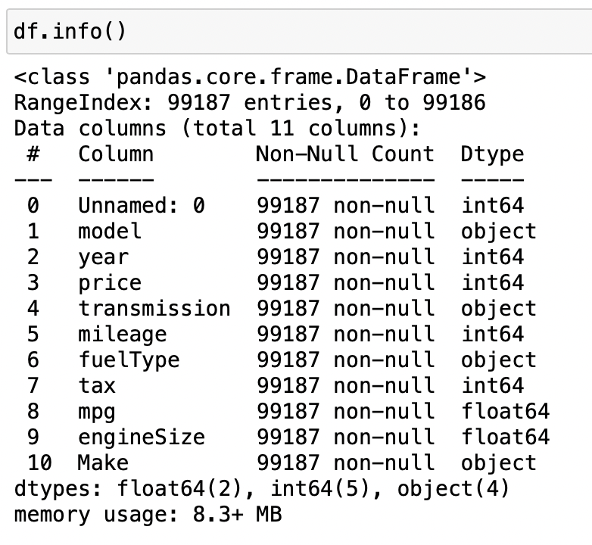
Data Processing
df.info gives a summary of the data
This shows that some of the columns dtypes are object and float
Because of these dtypes, I won’t be able to continue my LR without changing them to integers

Slide 7
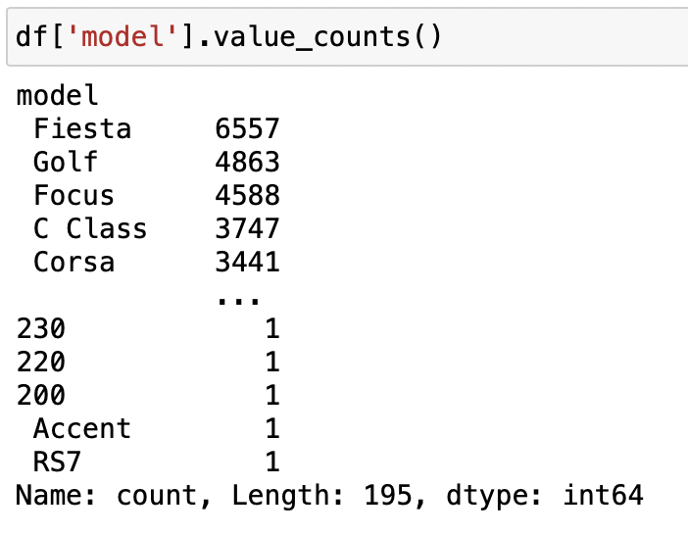
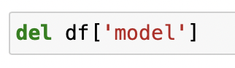
Data Processing
I used value_counts() to see the variety of different data in the column ’model’
Since there was a large amount of variety, I went ahead and deleted the column to make the linear regression easier to complete

Slide 8
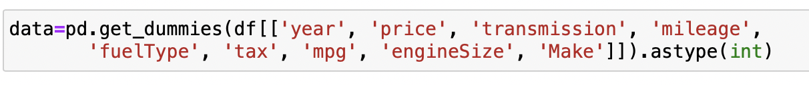
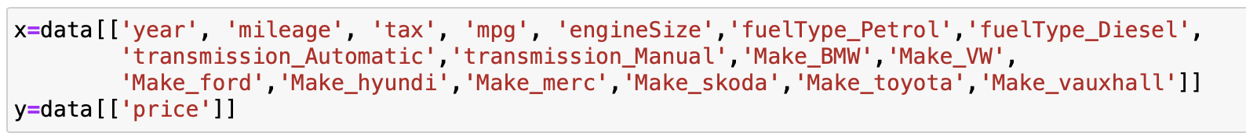
Data Processing
Since there are multiple categorical variable (dtypes: object and float), pd.get_dummies is used to make everything an int
After making every column an int, x and y variables are defined, making the y variable price because that is what is being predicted

Slide 9
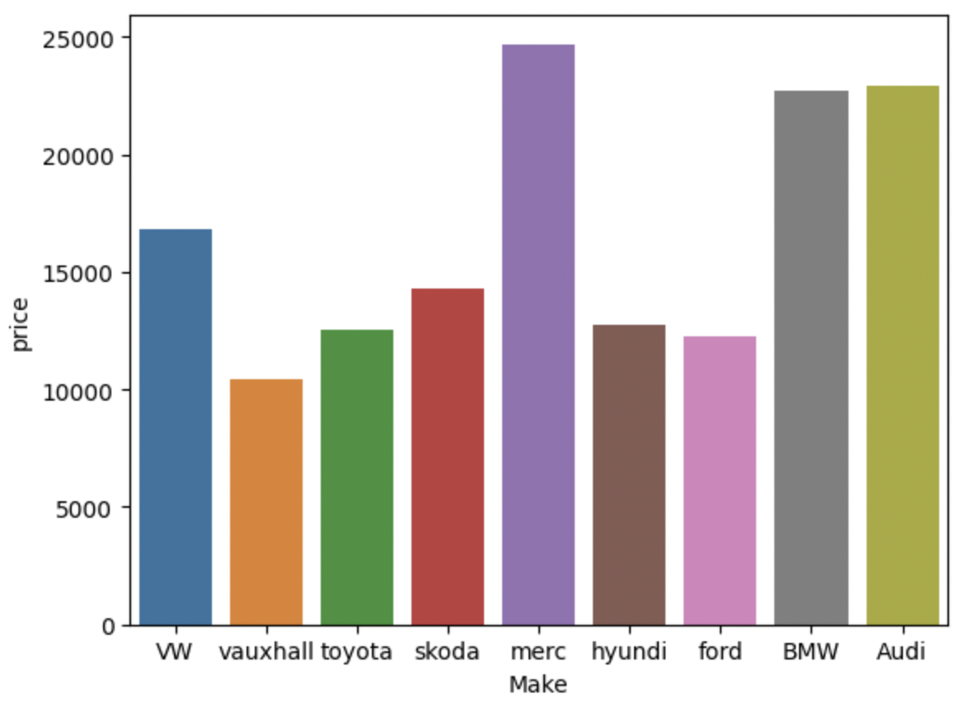
Visuals
This bar graph is comparing the make of the car and the price
The results of the graph show that Mercedes has the highest price of around $25,000 and Vauxhall has the lowest price of around $10,000

Slide 10
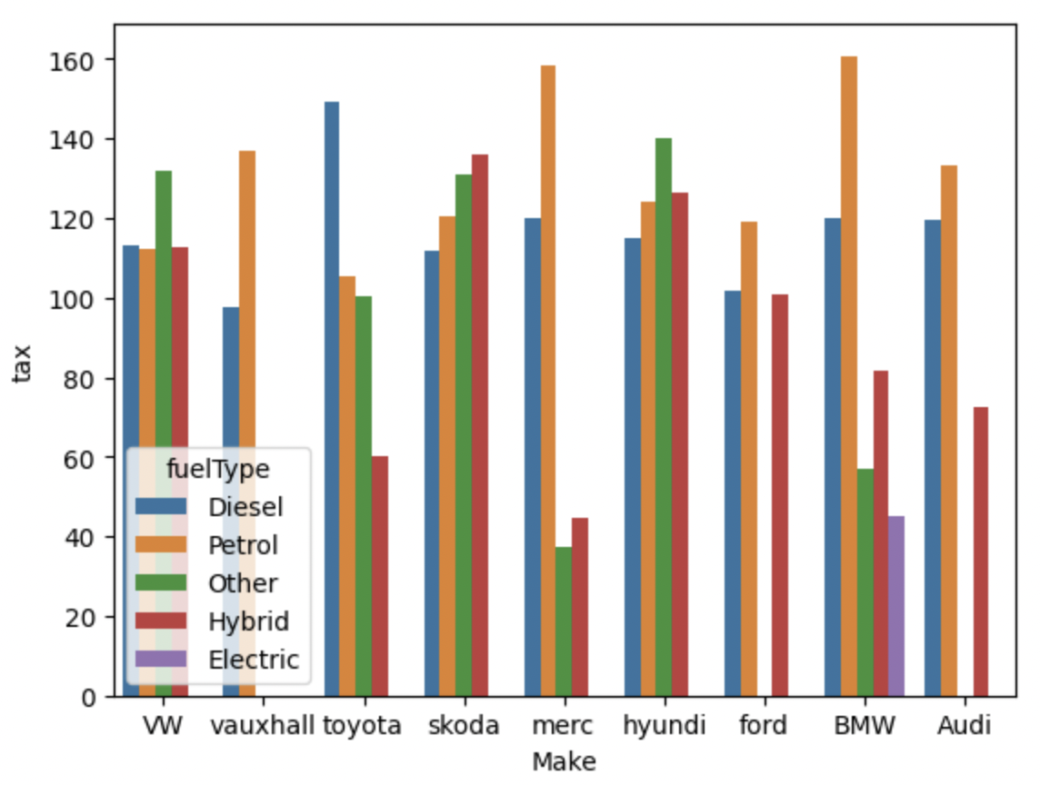
Visuals
This bar graph is comparing the make of the car and the tax the car has with the hue as the fueltype
The results of the graph show a consistency of high tax with petrol as the fueltype. There is also a consistency of low tax with hybrid as the fueltype

Slide 11
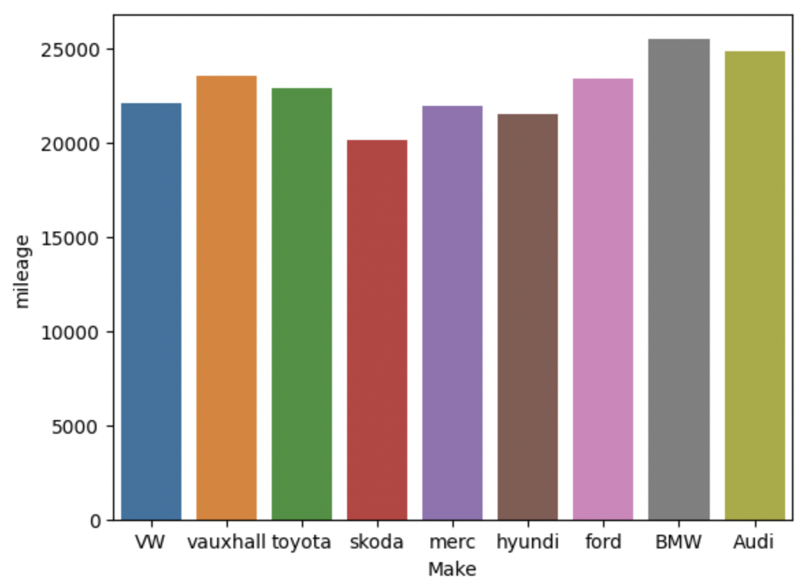
Visuals
This bar graph compares the make of the car and the mileage used
The results of this graph shows that every make is over 20,000 miles except Skoda. This also shows BMW has the most miles used with about 25,000 miles

Slide 12
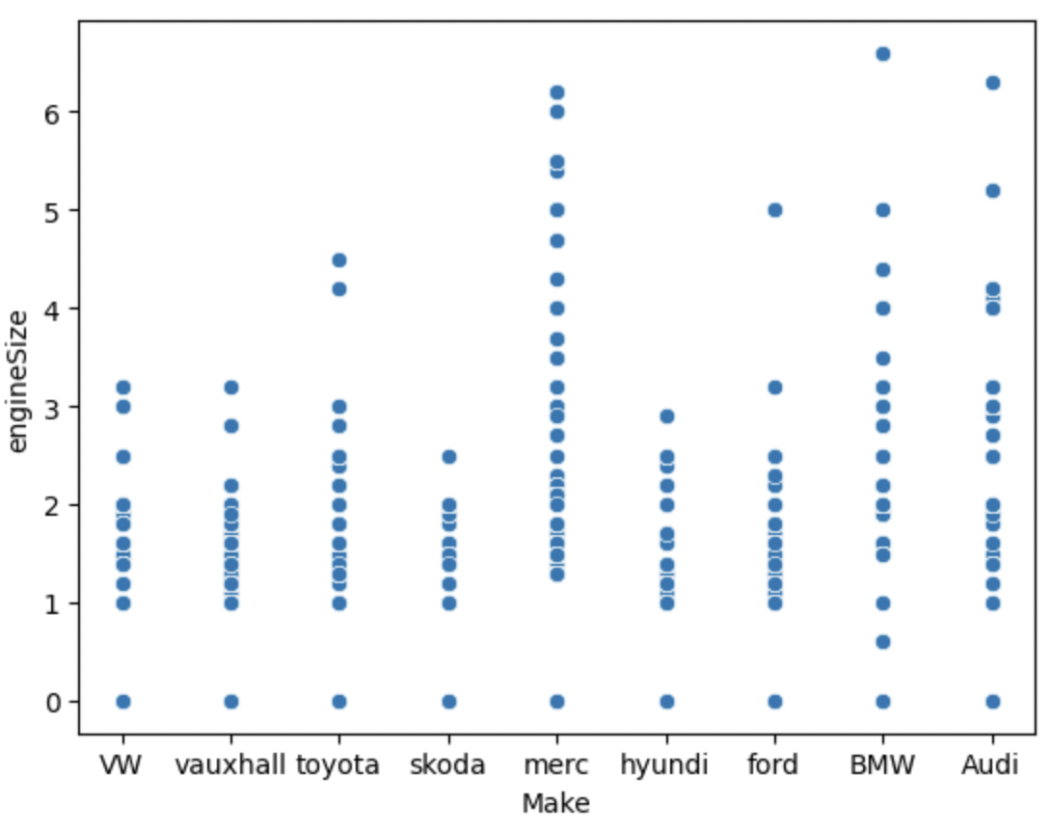
Visuals
This scatter plot compares the make of the car and the engine size
The results of the graph show that Mercedes has the widest variety of engine sizes, but BMW has the biggest engine

Slide 13
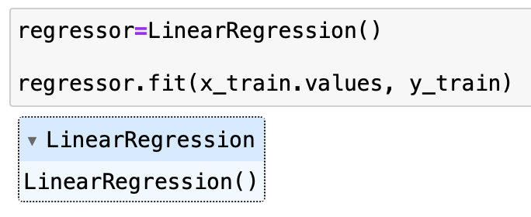
Training and Testing
For training and testing my dataset, I used sklearn.model_selection to split data into train and test sets
Using sklearn.linear_model implies that the model is specified as a linear combination
Using .fit is another way I trained my model

Slide 14
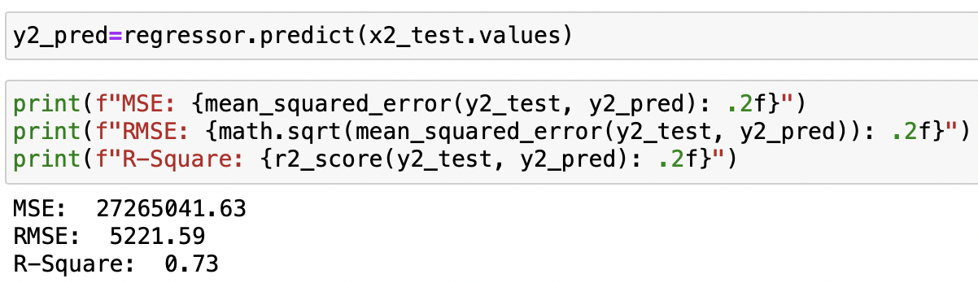
Splitting Data – 10%
When splitting the data, I use test_size to determine the portion of the data that will go into the test set at random
In this split, I used 10% as my test_size to see the accuracy
This shows that the size has a 73% accuracy

Slide 15
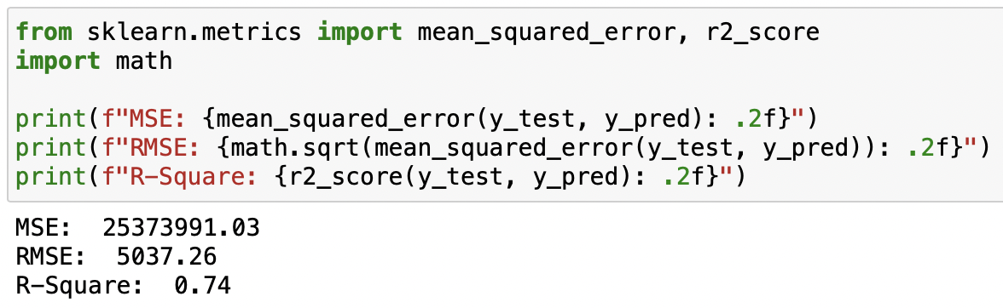
Splitting Data – 20%
My second split I used 20% of the data to see if the accuracy changed
As you can see, there is a 74% accuracy with this test size

Slide 16
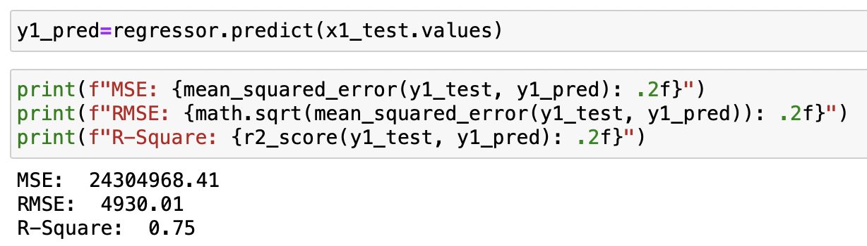
Splitting Data – 45%
For my final split, I used 45% of the data to see what the accuracy was
This shows that there is a 75% accuracy with this test size
Since this is the highest accuracy out of the 3, I will be using this split to make my predictions

Slide 17
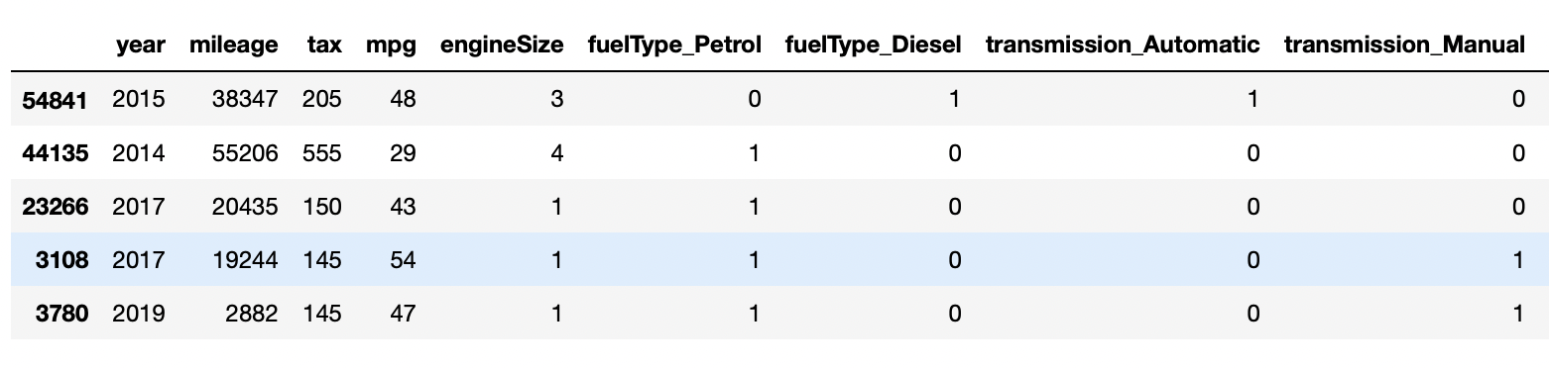
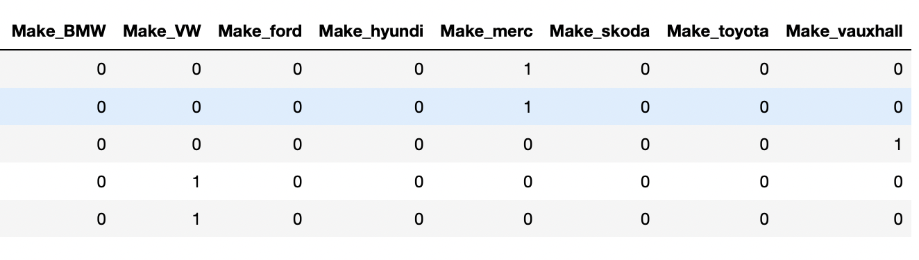
Predicting Cases

Slide 18
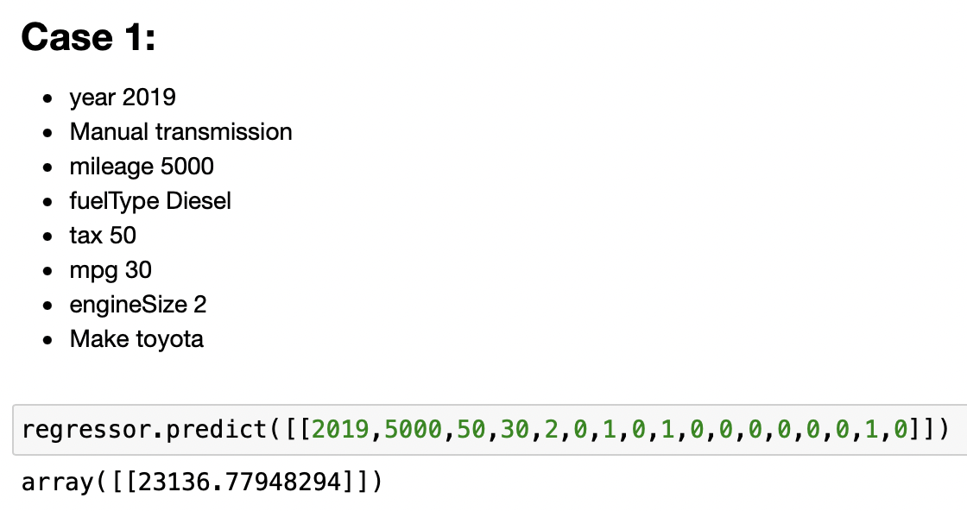
Prediction cases – Case 1

Slide 19
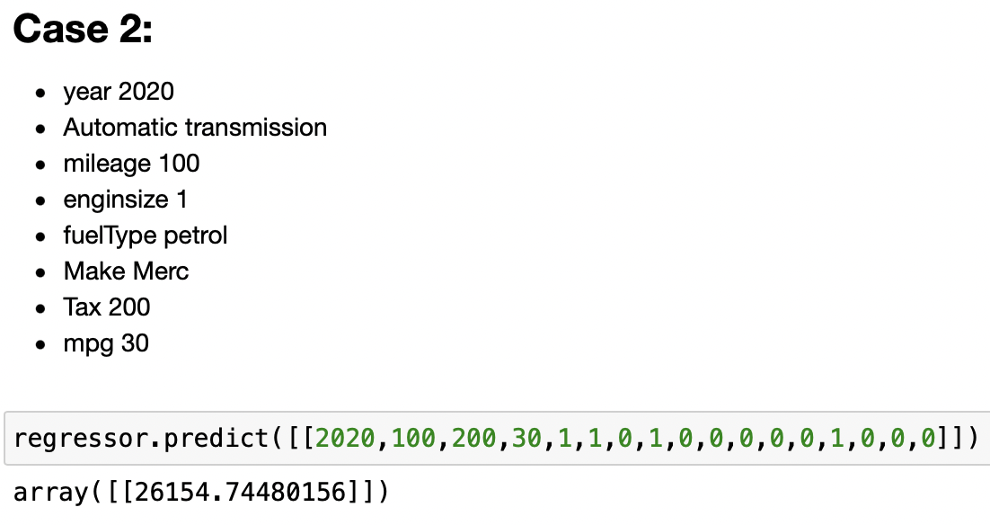
Predicting Cases – Case 2

Slide 20
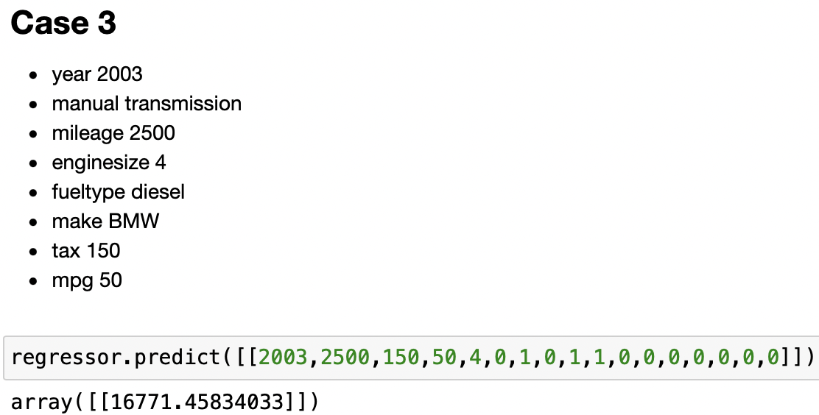
Predicting Cases – Case 3

Slide 21
Results
Problems I faced
Having to delete the model column
Changing the categorical variables because I had to write out every sub column (very time consuming)
Finding test sizes that had different accuracy percentages because most of them gave me the same results
Improvements
Finding a smaller dataset that allows me to work without needing to delete or change any of the data
Finding a dataset that interests me because this one was not a favorite

Slide 22
References
https://www.kaggle.com/datasets/harishkumardatalab/used-car-prediction-dataset
https://github.com/Reeseab03/Final_LR_RAB/blob/main/Final_LR_RAB.ipynb

